Slide 1

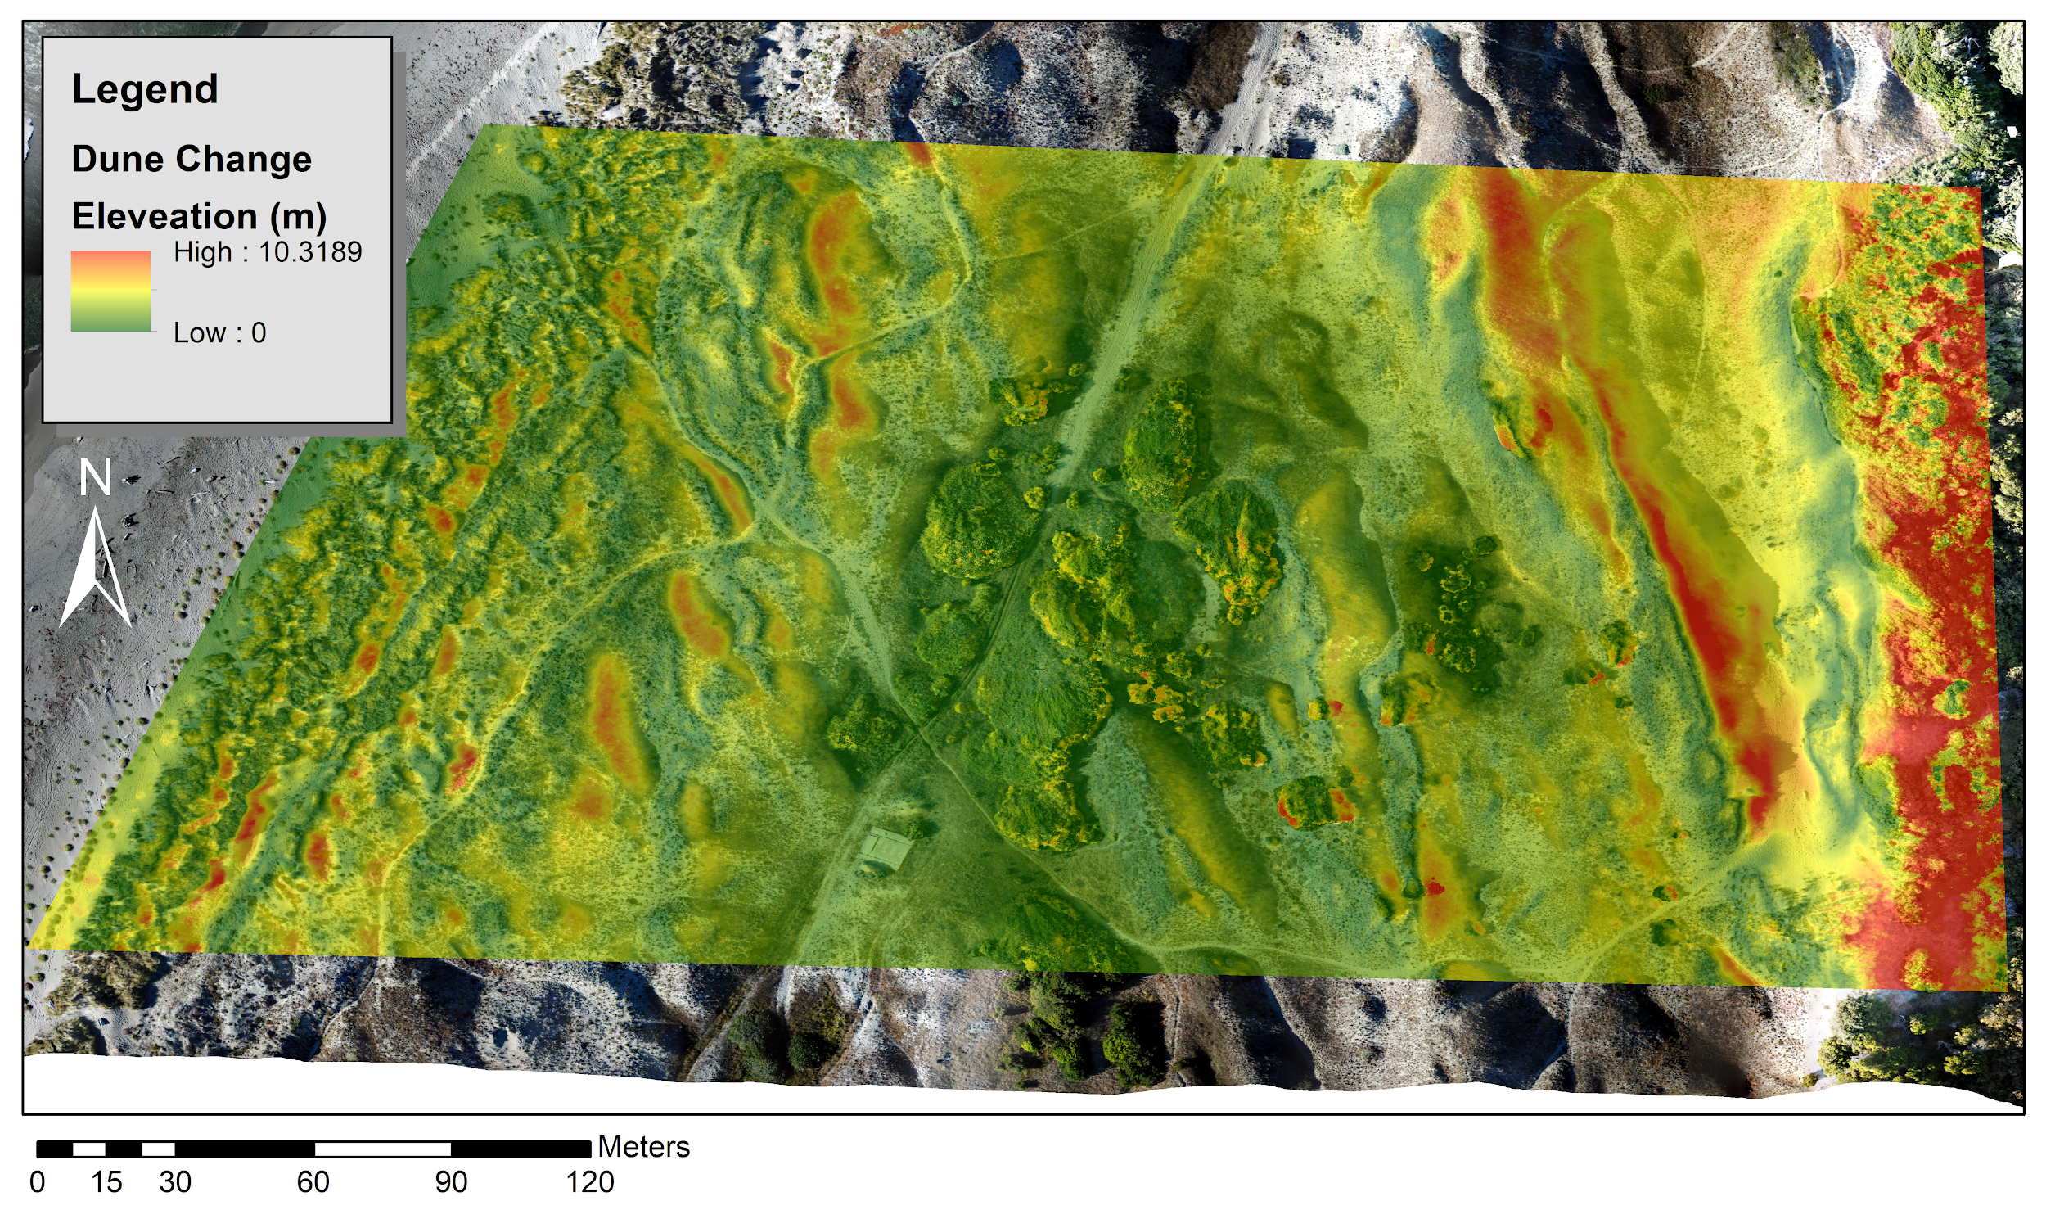
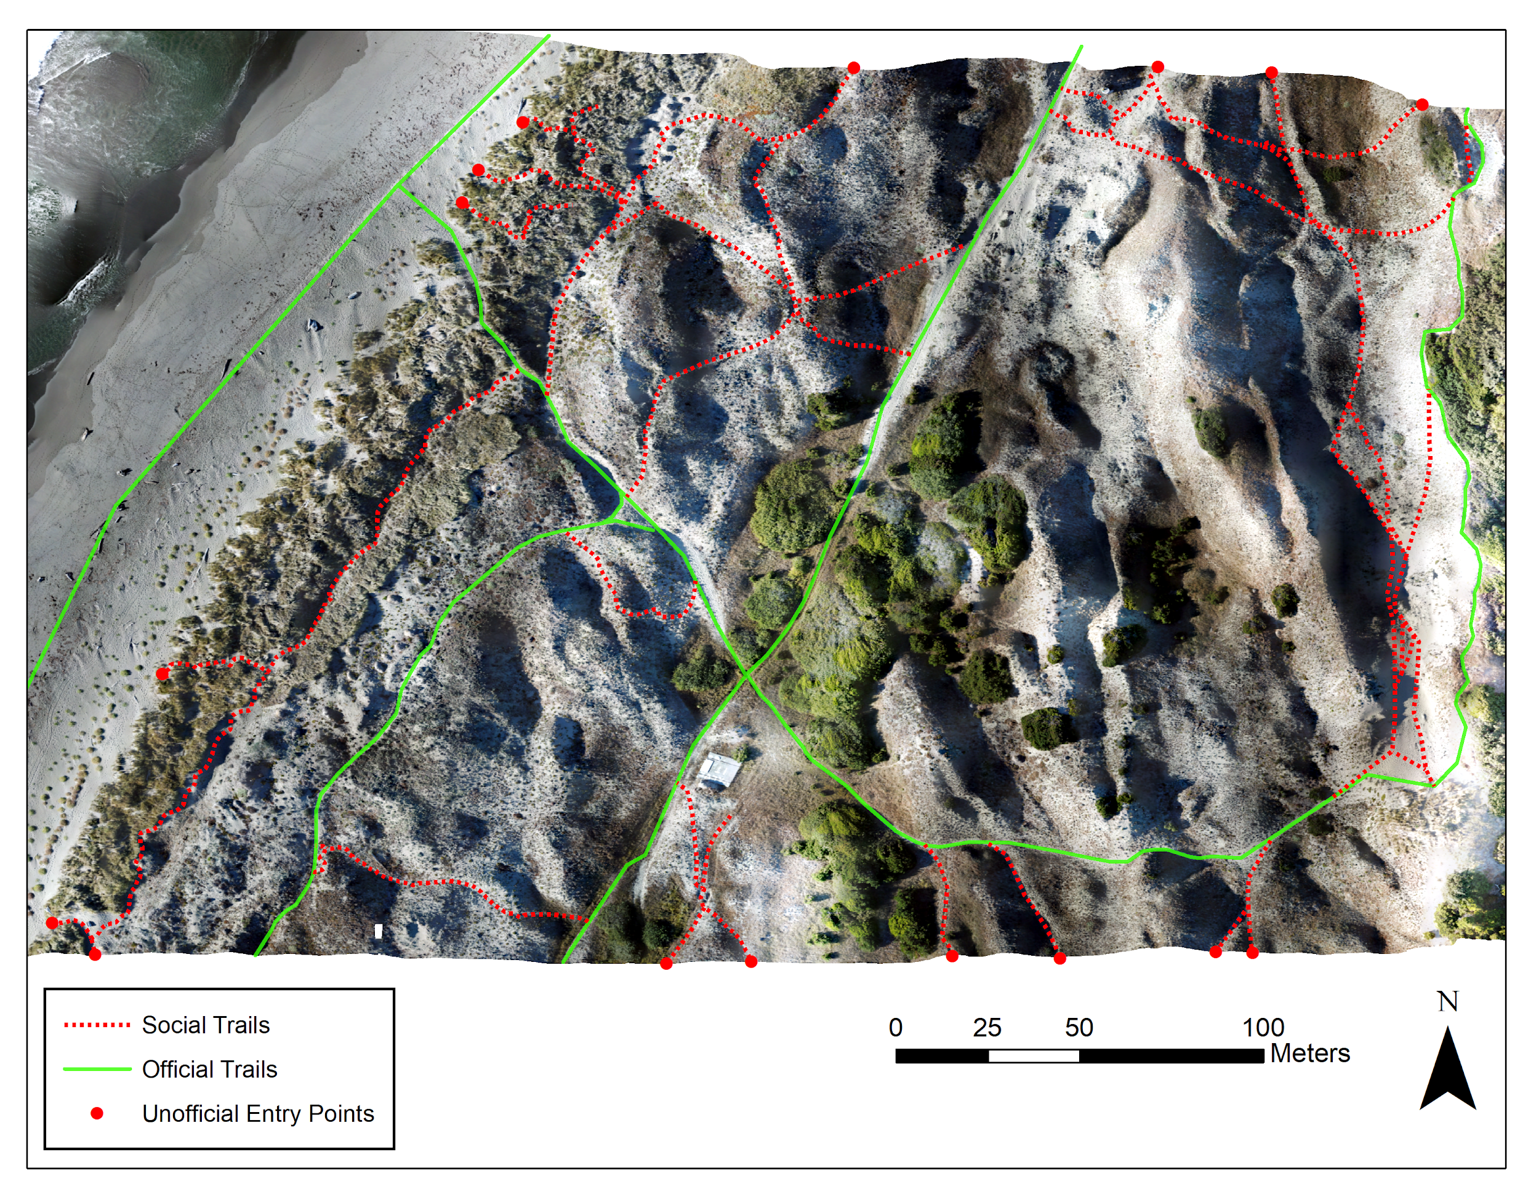
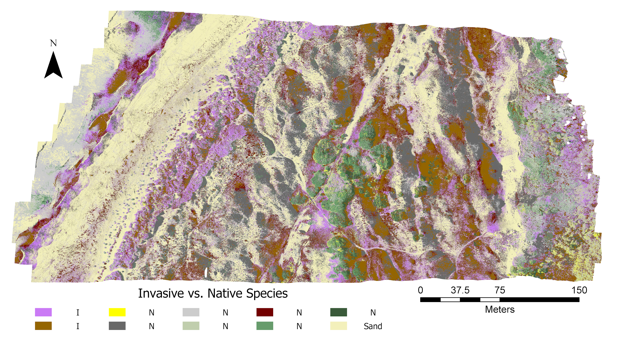
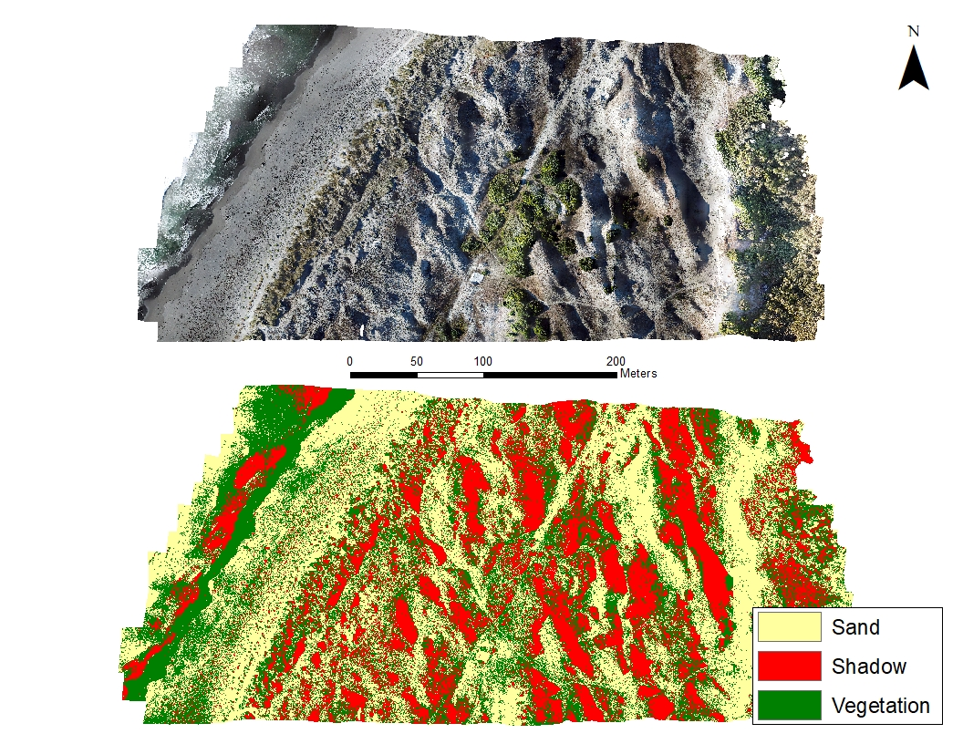
UAV Photogrammetry for Surveying Dune Habitats: A Review of Research Needs of the Friends of the Dunes Land Trust
Group 2
Jeffrey Kennedy
Samuel MacAdam
Simon Bueche
Robert Becker
Travis Massey
Charles Sandhu
Group 3
Kristy DeYoung
Samuel Wood
Lucy Corro
Michael Mcdermott
Christine Emerson
Aaron Christiansen
Group 4
Melanie Stevenson
Shayne Magstadt
Casey Thompson
Claire Thomas
Greg Stairs
John Soliz
Resource persons
Dr. Buddhika Madurapperuma
John Dellysse
Melissa Collin
Sean Fleming
Group 1
James Lamping
Brian Murphy
Jeremy McFarland
Zachery Porteous
Colleen Smith
Sierra Monroe
Group 1: Dune Movement
Group 2: Social Trails
Methods: A DJI Mavic Pro small Unmanned Aerial Vehicle (sUAV) was used to fly a 22.5 acre plot of the dunes managed by FOD at a height of about 30 m. The 427 images from this flight were used to create an orthomosaic image from Structure from motion (SfM) in Agisoft PhotoScan with 1.5 cm resolution. Ground control points were set up using real-time kinematic (RTK) GPS.
The 2018 Digital Surface Model (DSM) was created from the aerial photography and processed into a DSM. 2016 Lidar data of the area of interest was collected from NOAA and processed to create a DSM of the area. We used the two DSMs and the raster calculator to find the shifts in the Dunes
Methods: UAV imagery was used to visually identify social trails in the Friends of the Dunes Land Trust. All trails were digitized from the UAV imagery and existing maps were used to distinguish official trails from social trails. Entry points to social trails were also visually identified and the lengths of all trails were calculated using ArcGIS.
Results: Not including the Beach Trail, within the study area, there are 970 meters of official trails and 1701 meters of social trails. This means there is roughly 1.8 meters of social trail for every meter of official trail. A total of 16 unofficial points of entry were identified. This comes to 106 meters of social trail for every unofficial entry point.
Results: We used the absolute value of the difference of the two DSMs which emphasized the shifts in dune movements over the last two years. While most of the area of interest did not have significant difference in elevation, the largest amount of change can be seen on the north eastern facing slopes that are not directly exposed to wind from the ocean.
Group 3: Invasive Species
Group 4: Classification
Methods: To identify non-native species in the area of interest, we utilized Maximum Likelihood Classification in ArcMap with a mosaiced orthoimage. Maximum likelihood classification compares the variances and covariances of spectral signature classes developed from digitized training data to create mutually exclusive spectral classes. When creating our training dataset, ground truth data was obtained to identify specific land-use/cover types in the field, which improved the development of training classes.
Methods : We developed classes of land cover type (ie. sand, vegetation, and shadow). Using these predetermined classes, unknown land cover will be identified using the supervised classification method. To determine overall accuracy, 50 random points will be generated and manually classified. The supervised layer will identify the land cover at the random points. These points will be compared to the manual classification results to determine overall accuracy.
Results: With the high resolution imagery, an overall classification accuracy of 80.79% was calculated for three land types. Sand was classified with an accuracy of 76.19%, shaded areas were classified with an accuracy of 92.85%, and vegetation was classified with an accuracy of 73.33%. To avoid the possibility of the accuracy assessment being due to chance, a Kappa value was calculated for all three classes and was determined to be 0.698.
Results: The above methodology resulted in a pseudo-supervised classification which identifies different types of vegetation and thus invasive species in the FOD area. Maximum Likelihood classification was used instead of Feature Extraction because it allows analysis to be done on a larger scale.
Conclusion: Feature extraction methods and the use of NDVI were the desired methods to identify invasive species. With out near infrared imagery Maximum Likelihood classification provided the best results.
Conclusion: Using imagery collected from a UAV, land cover over small areas of interest can be classified using the supervised classification toolset in ENVI and the extract multi values to points tool in ArcGIS.
Acknowledgements: James Lamping, an FAA Certified Remote Pilot, flew the UAV under FAA regulations and with permission
from HSU Unmanned Aircraft System (UAS) Review Committee and Friends of the Dunes.

